Slide 1
Graphics for Website

Slide 2
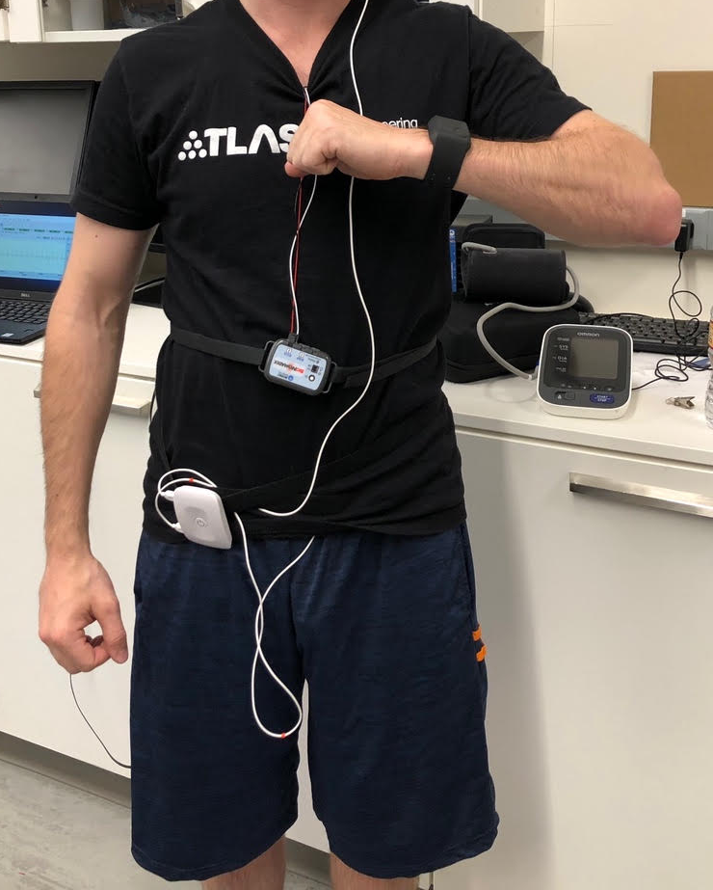
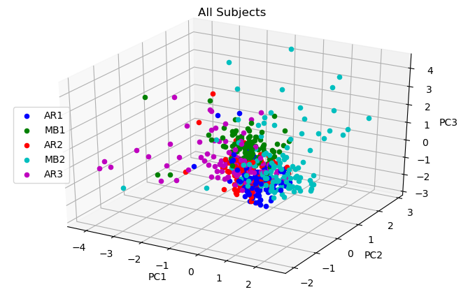
TASK CLASSIFICATION
Task 1
Task 2
Task 3
Task 4
Task 5

Slide 3
